Slide 1
CPM/PERT/Gantt Chart/ WBS
Extra Resources
Khayyam H. MASIYEV
BHOS☺
Information Security Division
Senior Lecturer
khayyam.masiyev@bhos.edu.az

Slide 2
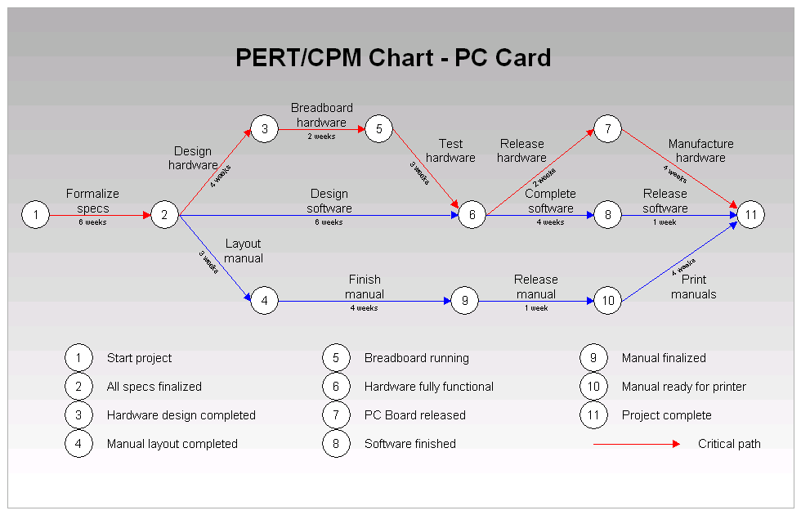
Project Management
CPM/PERT

Slide 3
What exactly is a project?
PM 1 – I’m in charge of the construction of a retail development in the centre of a large town. There are 26 retail units and a super market in the complex. My main responsibilities are to co-ordinate the work of the various contractors to ensure that the project is completed to specification, within budget and on time.
PM 2 – I am directing a team of research scientists. We are running trials on a new analgesic drug on behalf of a pharmaceutical company. It is my responsibility to design the experiments and make sure that proper scientific and legal procedures are followed, so that our results can be subjected to independent statistical analysis.
PM 3- The international aid agency which employs me is sending me to New Delhi to organize the introduction of multimedia resources at a teachers’ training college. My role is quite complex. I have to make sure that appropriate resources are purchased- and in some cases developed within the college. I also have to encourage the acceptance of these resources by lecturers and students within the college.

Slide 4
PM 1 – I’m in charge of the construction of a retail development in the centre of a large town. There are 26 retail units and a super market in the complex. My main responsibilities are to co-ordinate the work of the various contractors to ensure that the project is completed to specification, within budget and on time.
A shopping complex
PM 2 – I am directing a team of research scientists. We are running trials on a new analgesic drug on behalf of a pharmaceutical company. It is my responsibility to design the experiments and make sure that proper scientific and legal procedures are followed, so that our results can be subjected to independent statistical analysis.
A new drug
PM 3- The international aid agency which employs me is sending me to New Delhi to organize the introduction of multimedia resources at a teachers’ training college. My role is quite complex. I have to make sure that appropriate resources are purchased- and in some cases developed within the college. I also have to encourage the acceptance of these resources by lecturers and students within the college.
A new method of teaching students
Project is not defined by the type of outcome it is set up to achieve

Slide 5
Characteristic of a project
Project
A project is a temporary endeavour involving a connected sequence of activities and a range of resources, which is designed to achieve a specific and unique outcome and which operates within time, cost and quality constraints and which is often used to introduce change.
A unique, one-time operational activity or effort
Requires the completion of a large number of interrelated activities
Established to achieve specific objective
Resources, such as time and/or money, are limited
Typically has its own management structure
Need leadership

Slide 6
Examples
  constructing houses, factories, shopping malls, athletic stadiums or arenas
  developing military weapons systems, aircrafts, new ships
  launching satellite systems
  constructing oil pipelines
  developing and implementing new computer systems
  planning concert, football games, or basketball tournaments
  introducing new products into market

Slide 7
What is project management
The application of a collection of tools and techniques to direct the use of diverse resources towards the accomplishment of a unique, complex, one time task within time, cost and quality constraints.
Its origins lie in World War II, when the military authorities used the techniques of operational research to plan the optimum use of resources.
One of these techniques was the use of networks to represent a system of related activities

Slide 8
Project Management Process
Project planning
Project scheduling
Project control
Project team
  made up of individuals from various areas and departments within a company
Matrix organization
  a team structure with members from functional areas, depending on skills required
Project Manager
  most important member of project team
Scope statement
  a document that provides an understanding, justification, and expected result of a project
Statement of work
  written description of objectives of a project
Organizational Breakdown Structure
  a chart that shows which organizational units are responsible for work items
Responsibility Assignment Matrix
  shows who is responsible for work in a project

Slide 9
Work breakdown structure
A method of breaking down a project into individual elements ( components, subcomponents, activities and tasks) in a hierarchical structure which can be scheduled and cost
It defines tasks that can be completed independently of other tasks, facilitating resource allocation, assignment of responsibilities and measurement and control of the project
It is foundation of project planning
It is developed before identification of dependencies and estimation of activity durations
It can be used to identity the tasks in the CPM and PERT

Slide 10
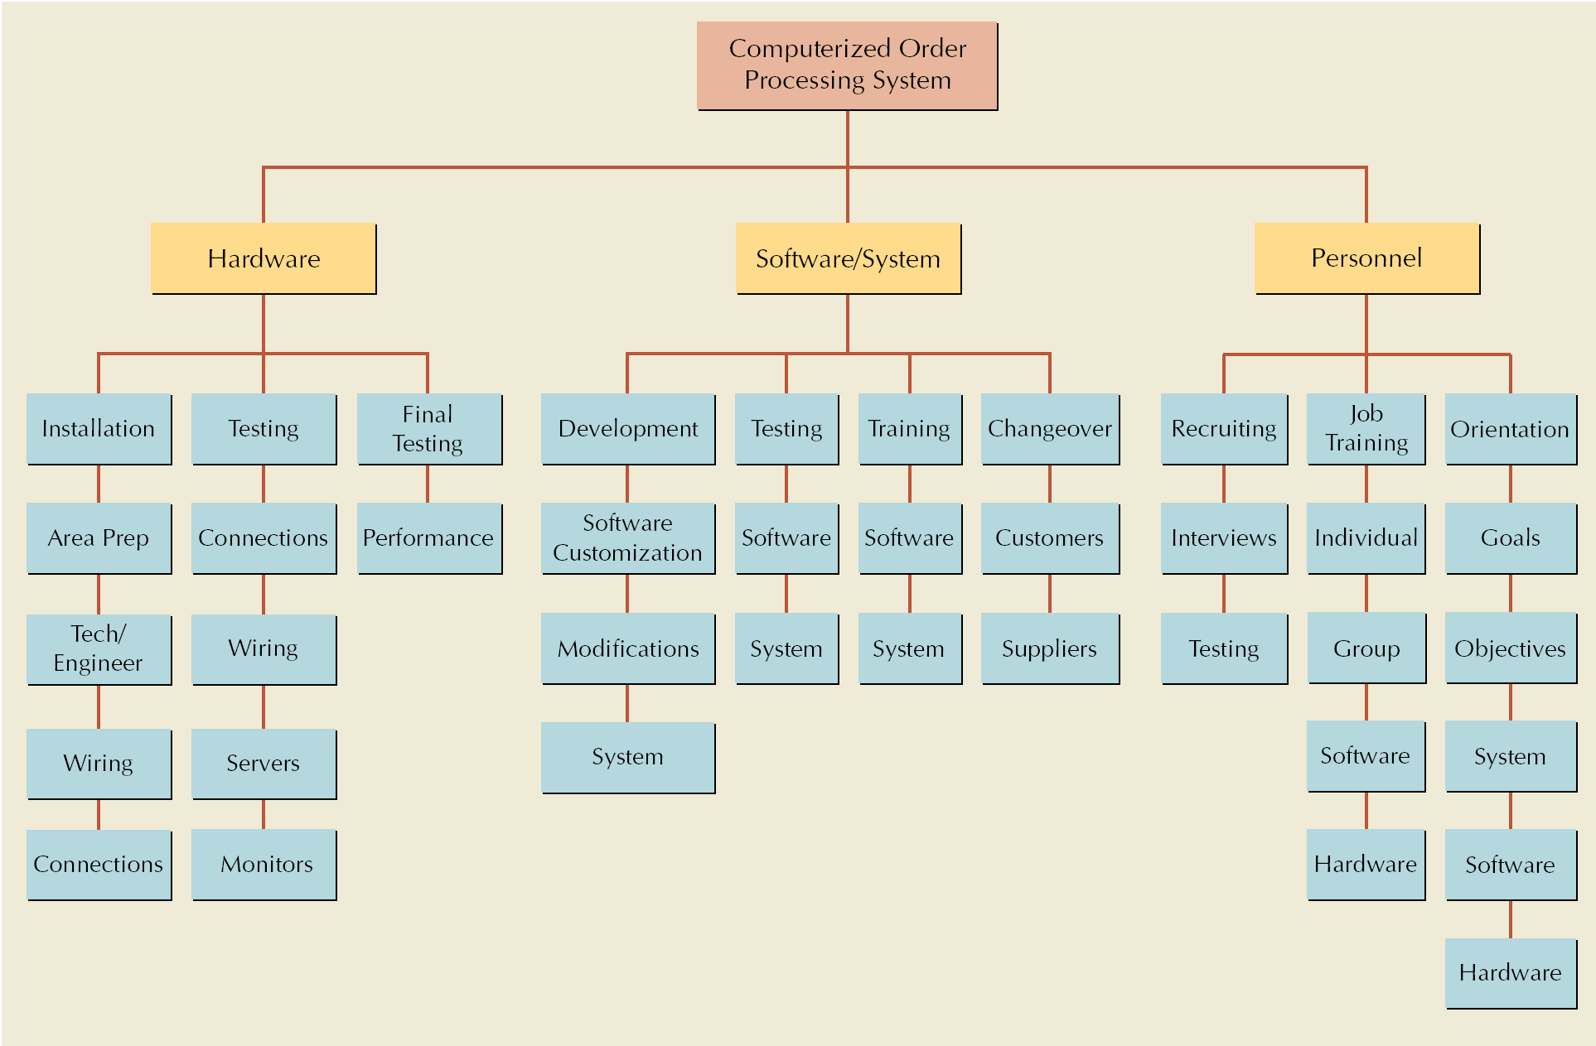
Work Breakdown Structure for Computer Order Processing System Project

Slide 11
Project Planning
Resource Availability and/or Limits
  Due date, late penalties, early completion incentives
  Budget
Activity Information
  Identify all required activities
  Estimate the resources required (time) to complete each activity
  Immediate predecessor(s) to each activity needed to create interrelationships

Slide 12
Project Scheduling and Control Techniques
Gantt Chart
Critical Path Method (CPM)
Program Evaluation and Review Technique (PERT)

Slide 13
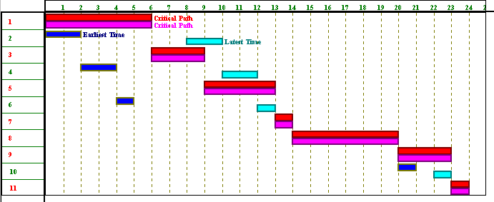
Gantt Chart
Graph or bar chart with a bar for each project activity that shows passage of time
Provides visual display of project schedule

Slide 14
History of CPM/PERT
Critical Path Method (CPM)
  E I Du Pont de Nemours & Co. (1957) for construction of new chemical plant and maintenance shut-down
  Deterministic task times
  Activity-on-node network construction
  Repetitive nature of jobs
Project Evaluation and Review Technique (PERT)
  U S Navy (1958) for the POLARIS missile program
  Multiple task time estimates (probabilistic nature)
  Activity-on-arrow network construction
  Non-repetitive jobs (R & D work)

Slide 15
Project Network
Network analysis is the general name given to certain specific techniques which can be used for the planning, management and control of projects
Use of nodes and arrows
Arrows ➔ An arrow leads from tail to head directionally
  Indicate ACTIVITY, a time consuming effort that is required to perform a part of the work.
  Nodes  A node is represented by a circle
  - Indicate EVENT, a point in time where one or more activities start and/or finish.
Activity
  A task or a certain amount of work required in the project
  Requires time to complete
  Represented by an arrow
Dummy Activity
  Indicates only precedence relationships
  Does not require any time of effort

Slide 16
Project Network
Event
  Signals the beginning or ending of an activity
  Designates a point in time
  Represented by a circle (node)
Network
  Shows the sequential relationships among activities using nodes and arrows
Activity-on-node (AON)
  nodes represent activities, and arrows show precedence relationships
Activity-on-arrow (AOA)
  arrows represent activities and nodes are events for points in time

Slide 17
AOA Project Network for House
3
Lay foundation
Dummy
2
0
Build house
Finish work
1
3
2
1
4
6
7
Design house and obtain financing
Order and receive materials
3
1
1
1
Select paint
Select carpet
5
AON Project Network for House
Lay foundations
Build house
2
4
2
3
Finish work
7
Start
1
1
3
Design house and obtain financing
3
6
1
5
1
1
Select carpet
Order and receive materials
Select paint

Slide 18
Situations in network diagram
B
A
A must finish before either B or C can start
C
A
C
both A and B must finish before C can start
B
A
C
both A and C must finish before either of B or D can start
B
D
A
B
A must finish before B can start
both A and C must finish before D can start
Dummy
C
D

Slide 20
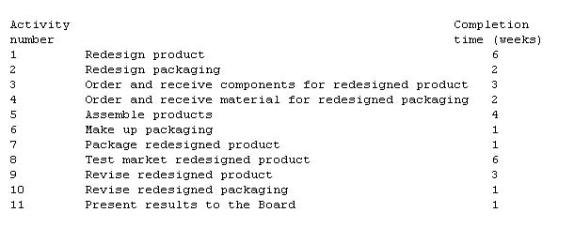
Network example
Illustration of network analysis of a minor redesign of a product and its associated packaging.
The key question is: How long will it take to complete this project ?

Slide 21
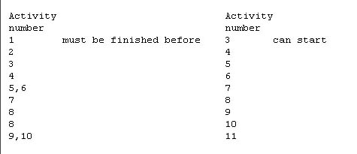
For clarity, this list is kept to a minimum by specifying only immediate relationships, that is relationships involving activities that "occur near to each other in time".

Slide 22
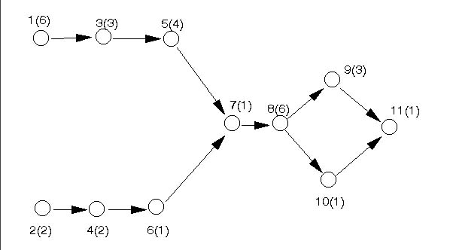
Questions to prepare activity network
Is this a Start Activity?
Is this a Finish Activity?
What Activity Precedes this?
What Activity Follows this?
What Activity is Concurrent with this?

Slide 23
CPM calculation
Path
  A connected sequence of activities leading from the starting event to the ending event
Critical Path
  The longest path (time); determines the project duration
Critical Activities
  All of the activities that make up the critical path

Slide 24
Forward Pass
Earliest Start Time (ES)
  earliest time an activity can start
  ES = maximum EF of immediate predecessors
Earliest finish time (EF)
  earliest time an activity can finish
  earliest start time plus activity time
    EF= ES + t
Backward Pass
Latest Start Time (LS)
  Latest time an activity can start without delaying critical path time
    LS= LF - t
Latest finish time (LF)
  latest time an activity can be completed without delaying critical path time
  LS = minimum LS of immediate predecessors

Slide 25
CPM analysis
Draw the CPM network
Analyze the paths through the network
Determine the float for each activity
  Compute the activity’s float
  float = LS - ES = LF - EF
  Float is the maximum amount of time that this activity can be delay in its completion before it becomes a critical activity, i.e., delays completion of the project
Find the critical path is that the sequence of activities and events where there is no “slack” i.e.. Zero slack
  Longest path through a network
Find the project duration is minimum project completion time

Slide 26
CPM Example:
CPM Network
f, 15
g, 17
h, 9
a, 6
i, 6
b, 8
d, 13
j, 12
c, 5
e, 9

Slide 27
CPM Example
ES and EF Times
f, 15
g, 17
h, 9
a, 6
0
6
i, 6
b, 8
0
8
d, 13
j, 12
c, 5
0
5
e, 9

Slide 28
CPM Example
ES and EF Times
f, 15
6
21
g, 17
h, 9
a, 6
0
6
6
23
i, 6
b, 8
0
8
d, 13
j, 12
8
21
c, 5
0
5
e, 9
5
14

Slide 29
CPM Example
f, 15
ES and EF Times
6
21
g, 17
h, 9
a, 6
21
30
0
6
6
23
i, 6
23
29
b, 8
0
8
d, 13
j, 12
8
21
21
33
c, 5
0
5
e, 9
Project’s EF = 33
5
14

Slide 30
CPM Example
f, 15
LS and LF Times
6
21
h, 9
21
30
a, 6
g, 17
24
33
0
6
6
23
i, 6
23
29
b, 8
27
33
0
8
d, 13
j, 12
8
21
21
33
c, 5
21
33
0
5
e, 9
5
14

Slide 31
CPM Example
LS and LF Times
f, 15
6
21
h, 9
18
24
21
30
a, 6
g, 17
24
33
0
6
6
23
i, 6
4
10
10
27
23
29
b, 8
27
33
0
8
d, 13
j, 12
0
8
8
21
21
33
c, 5
8
21
21
33
0
5
e, 9
7
12
5
14
12
21

Slide 32
CPM Example
Float
f, 15
6
21
3
h, 9
9
24
21
30
a, 6
g, 17
3
24
33
0
6
6
23
i, 6
3
4
3
9
10
27
23
29
4
b, 8
27
33
0
8
d, 13
j, 12
0
0
8
8
21
21
33
0
0
c, 5
8
21
21
33
0
5
e, 9
7
7
12
5
14
7
12
21

Slide 33
CPM Example
Critical Path
f, 15
g, 17
h, 9
a, 6
i, 6
b, 8
d, 13
j, 12
c, 5
e, 9

Slide 34
PERT
PERT is based on the assumption that an activity’s duration follows a probability distribution instead of being a single value
Three time estimates are required to compute the parameters of an activity’s duration distribution:
  pessimistic time (t_{p} ) - the time the activity would take if things did not go well
  most likely time (t_{m} ) - the consensus best estimate of the activity’s duration
  optimistic time (t_{o} ) - the time the activity would take if things did go well
t_{p} + 4 t_{m} + t_{o}
6
Mean (expected time): t_{e} =
2
t_{p} - t_{o}
6
Variance: V_{t} =σ ² =

Slide 35
PERT analysis
Draw the network.
Analyze the paths through the network and find the critical path.
The length of the critical path is the mean of the project duration probability distribution which is assumed to be normal
The standard deviation of the project duration probability distribution is computed by adding the variances of the critical activities (all of the activities that make up the critical path) and taking the square root of that sum
Probability computations can now be made using the normal distribution table.

Slide 36
Probability computation
Determine probability that project is completed within specified time
x - μ
Z =
σ
where μ = t_{p} = project mean time
σ = project standard mean time
x = (proposed ) specified time

Slide 38
PERT Example
Immed. Optimistic Most Likely Pessimistic
Activity Predec. Time (Hr.) Time (Hr.) Time (Hr.)
A -- 4 6 8
B -- 1 4.5 5
C A 3 3 3
D A 4 5 6
E A 0.5 1 1.5
F B,C 3 4 5
G B,C 1 1.5 5
H E,F 5 6 7
I E,F 2 5 8
J D,H 2.5 2.75 4.5
K G,I 3 5 7

Slide 39
PERT Example
PERT Network
D
A
E
H
J
C
B
I
K
F
G

Slide 40
PERT Example
Activity Expected Time Variance
A 6 4/9
B 4 4/9
C 3 0
D 5 1/9
E 1 1/36
F 4 1/9
G 2 4/9
H 6 1/9
I 5 1
J 3 1/9
K 5 4/9

Slide 41
PERT Example
Activity ES EF LS LF Slack
A 0 6 0 6 0 *critical
B 0 4 5 9 5
C 6 9 6 9 0 *
D 6 11 15 20 9
E 6 7 12 13 6
F 9 13 9 13 0 *
G 9 11 16 18 7
H 13 19 14 20 1
I 13 18 13 18 0 *
J 19 22 20 23 1
K 18 23 18 23 0 *

Slide 42
PERT Example
V_{path} = V_{A} + V_{C} + V_{F} + V_{I} + V_{K}
= 4/9 + 0 + 1/9 + 1 + 4/9
= 2
σ_{path} = 1.414
z = (24 - 23)/σ = (24-23)/1.414 = .71
From the Standard Normal Distribution table:
P(z < .71) = .5 + .2612 = .7612

Slide 43
PROJECT COST

Slide 44
Cost consideration in project
Project managers may have the option or requirement to crash the project, or accelerate the completion of the project.
This is accomplished by reducing the length of the critical path(s).
The length of the critical path is reduced by reducing the duration of the activities on the critical path.
If each activity requires the expenditure of an amount of money to reduce its duration by one unit of time, then the project manager selects the least cost critical activity, reduces it by one time unit, and traces that change through the remainder of the network.
As a result of a reduction in an activity’s time, a new critical path may be created.
When there is more than one critical path, each of the critical paths must be reduced.
If the length of the project needs to be reduced further, the process is repeated.

Slide 45
Project Crashing
Crashing
  reducing project time by expending additional resources
Crash time
  an amount of time an activity is reduced
Crash cost
  cost of reducing activity time
Goal
  reduce project duration at minimum cost

Slide 46
Activity crashing
Crash cost
Crashing activity
Slope = crash cost per unit time
Activity cost
Normal Activity
Normal cost
Normal time
Crash time
Activity time

Slide 47
Time-Cost Relationship
Crashing costs increase as project duration decreases
Indirect costs increase as project duration increases
Reduce project length as long as crashing costs are less than indirect costs
Time-Cost Tradeoff
Min total cost = optimal project time
Total project cost
Indirect cost
cost
Direct cost
time

Slide 48
Project Crashing example
2
4
8
12
7
1
4
12
3
6
4
5
4
4

Slide 49
Time Cost data
Activity | Normal time | Normal cost Rs | Crash time | Crash cost Rs | Allowable crash time | slope
1 2 3 4 5 6 7 | 12 8 4 12 4 4 4 | 3000 2000 4000 50000 500 500 1500 | 7 5 3 9 1 1 3 | 5000 3500 7000 71000 1100 1100 22000 | 5 3 1 3 3 3 1 | 400 500 3000 7000 200 200 7000
 |  | 75000 |  | 110700

Slide 50
R500
R7000
Project duration = 36
2
4
8
12
R700
7
From…..
1
4
12
R400
3
6
4
5
4
4
R200
R3000
R200
R500
R7000
2
4
8
12
R700
To…..
7
1
4
7
Project
duration = 31
Additional cost = R2000
R400
3
6
4
5
4
4
R200
R3000
R200

Slide 51
Benefits of CPM/PERT
Useful at many stages of project management
Mathematically simple
Give critical path and slack time
Provide project documentation
Useful in monitoring costs
CPM/PERT can answer the following important questions:
How long will the entire project take to be completed? What are the risks involved?
Which are the critical activities or tasks in the project which could delay the entire project if they were not completed on time?
Is the project on schedule, behind schedule or ahead of schedule?
If the project has to be finished earlier than planned, what is the best way to do this at the least cost?

Slide 52
Limitations to CPM/PERT
Clearly defined, independent and stable activities
Specified precedence relationships
Over emphasis on critical paths
Deterministic CPM model
Activity time estimates are subjective and depend on judgment
PERT assumes a beta distribution for these time estimates, but the actual distribution may be different
PERT consistently underestimates the expected project completion time due to alternate paths becoming critical
To overcome the limitation, Monte Carlo simulations can be performed on the network to eliminate the optimistic bias

Slide 53
Computer Software for Project Management
Microsoft Project (Microsoft Corp.)
MacProject (Claris Corp.)
PowerProject (ASTA Development Inc.)
Primavera Project Planner (Primavera)
Project Scheduler (Scitor Corp.)
Project Workbench (ABT Corp.)

Slide 54
Practice Example
A social project manager is faced with a project with the following activities:
Activity Description | Duration
Social work team to live in village | 5w
Social research team to do survey | 12w
Analyse results of survey | 5w
Establish mother & child health program | 14w
Establish rural credit programme | 15w
Carry out immunization of under fives | 4w
Draw network diagram and show the critical path. Calculate project duration.

Slide 55
Practice problem
Activity | Description | Duration
1-2 | Social work team to live in village | 5w
1-3 | Social research team to do survey | 12w
3-4 | Analyse results of survey | 5w
2-4 | Establish mother & child health program | 14w
3-5 | Establish rural credit programme | 15w
4-5 | Carry out immunization of under fives | 4w
4
2
1
5
3

